Slide 1
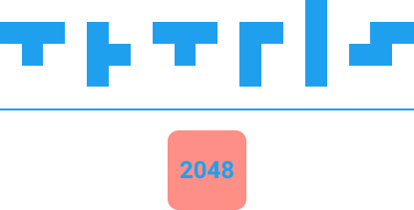

Ali Büyükberber, Ataman Fedai, Bayram Yağcı

Slide 2
What is the Tetris?
Tetris game is to gather scores by adjusting blocks properly onto the grid.

Slide 3
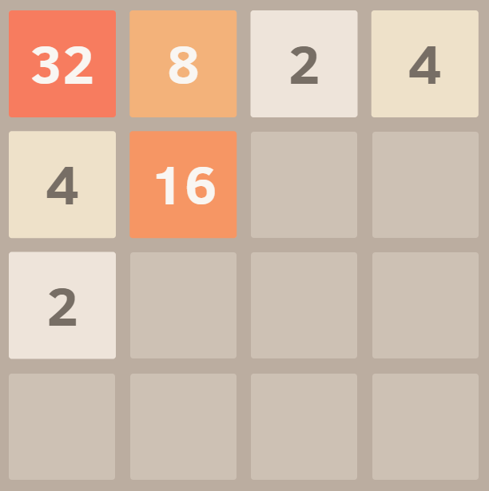
What is the 2048?
This game is a combination of the classic tetris game and 2048 games.

Slide 4
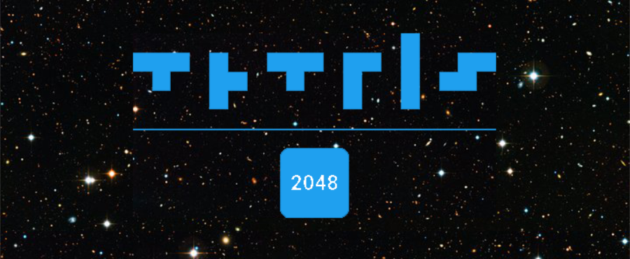
What is the Tetris 2048?
This game is a combination of the classic tetris game and 2048 games.

Slide 5
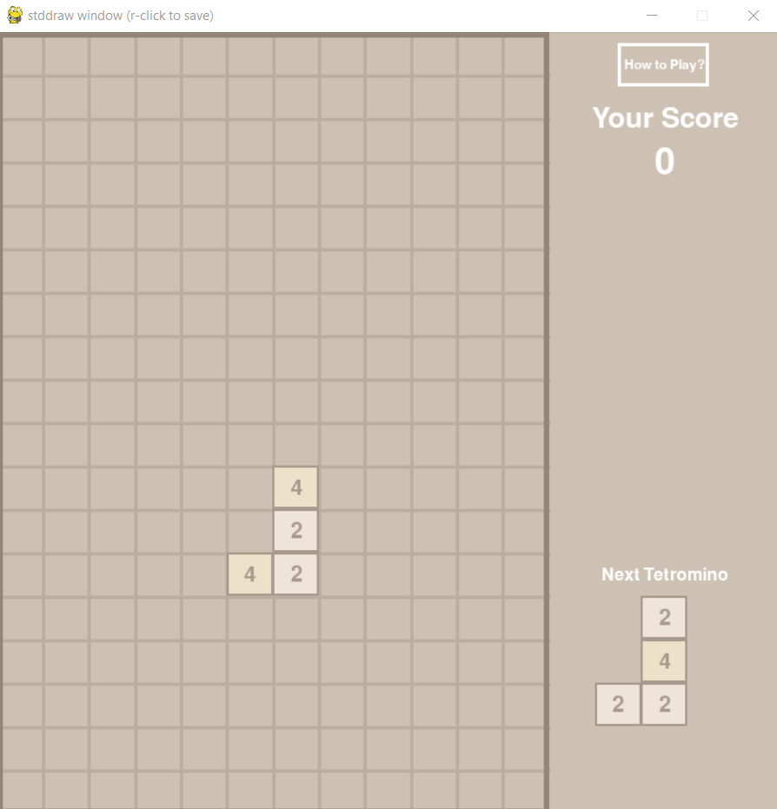
How to Play?
This game is a combination of the classic tetris game and 2048 games.

Slide 6
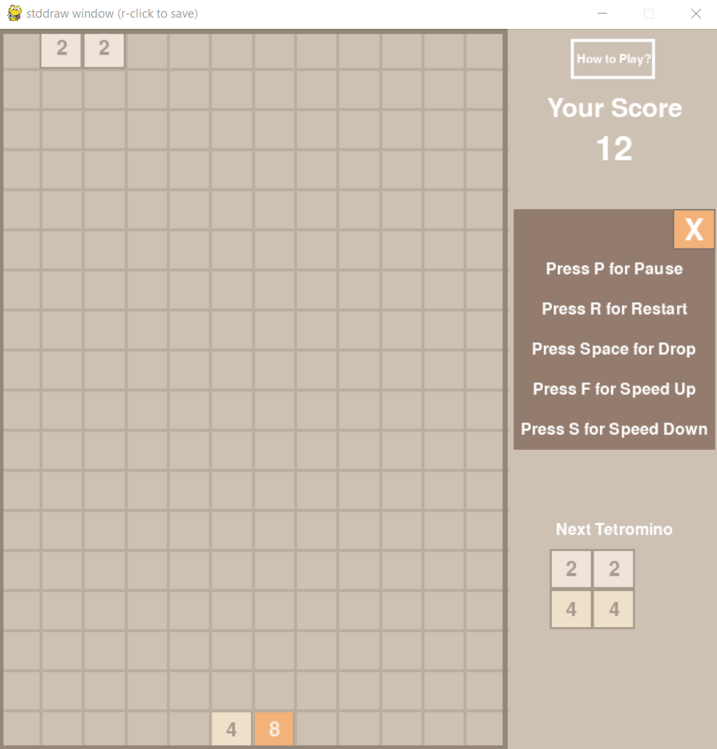
How to Play?
This game is a combination of the classic tetris game and 2048 games.

Slide 7
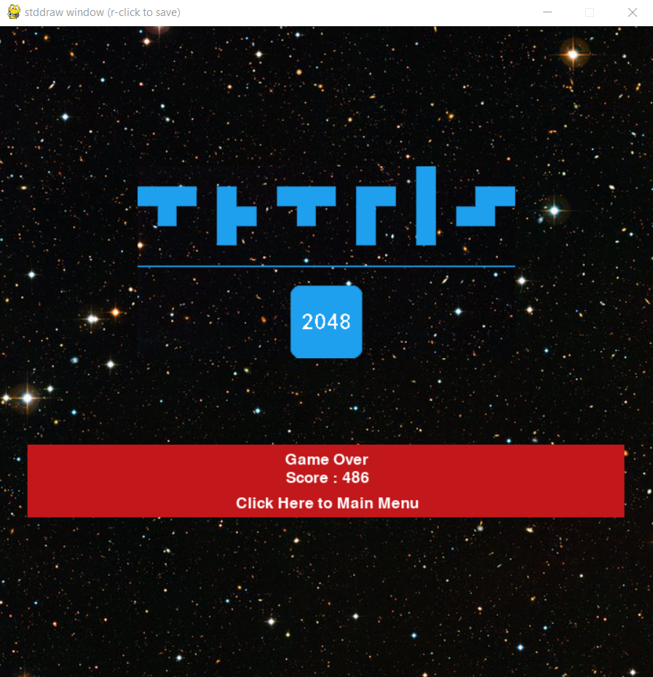
Game Over Menu
Gave Over Menu has a game score and restart button.

Slide 8
Thank You!
Ali Büyükberber, Ataman Fedai, Bayram Yağcı

